Slide 1

INSTITUTE : UIE
DEPARTMENT : CSE
Bachelor of Engineering (Computer Science & Engineering)
PROJECT BASED LEARNING IN JAVA
(20CST-319/20ITT-319)
TOPIC OF PRESENTATION:
Introduction to Java. Difference between C++ and Java.
DISCOVER . LEARN . EMPOWER

Slide 2

Lecture Objectives
In this lecture, we will discuss:
Introduction to Java. Difference between C++ and Java.

Slide 3
Java is a programming language and a platform. Java is a high level, robust, object-oriented and secure programming language.
Platform: Any hardware or software environment in which a program runs, is known as a platform. Since Java has a runtime environment (JRE) and API, it is called a platform.

Slide 4
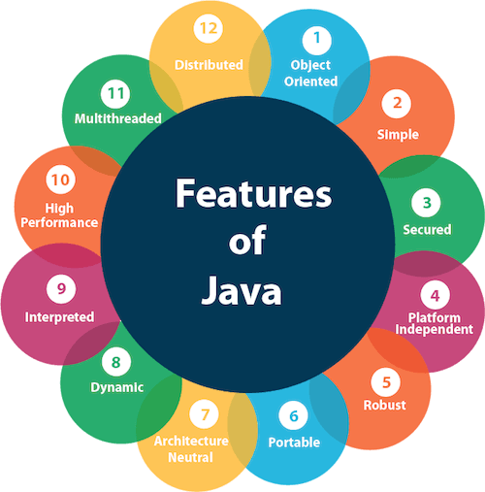

Slide 5
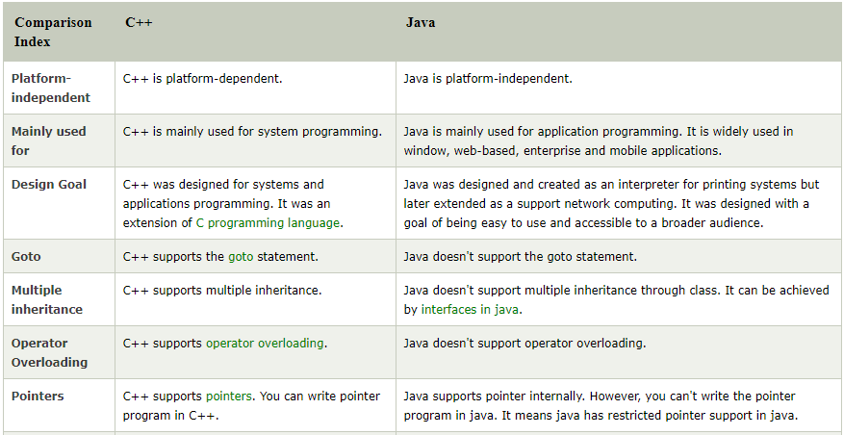

Slide 6
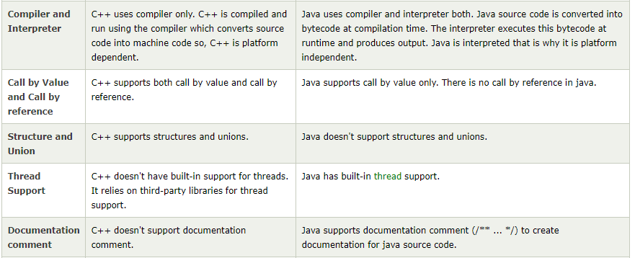

Slide 7
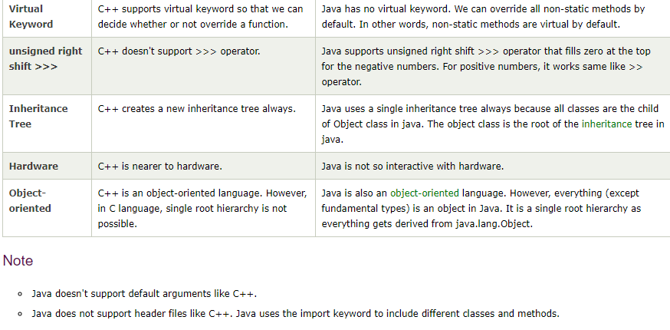

Slide 8
QUIZ:
1. Which of the following is a valid declaration of a char?
char ch = '\utea';
char ca = 'tea';
char cr = \u0223;
char cc = '\itea';
2. Which of the following tool is used to generate API documentation in HTML format from doc comments in source code?
javap tool
javaw command
Javadoc tool
javah command

Slide 9
Summary:
In this session, you were able to :
• Learn about Fundamentals of JAVA

Slide 10
References:
Books:
1. Balaguruswamy, Java.
2. A Primer, E.Balaguruswamy, Programming with Java, Tata McGraw Hill Companies
3. John P. Flynt Thomson, Java Programming.
Video Lectures :
https://youtu.be/O5hShUO6wxs
Reference Links:
https://www.tutorialspoint.com/java/java_polymorphism.htm
http://www.careerride.com/Object-oriented-programming-Interview-Questions.aspx
http://www.javatpoint.com/
http://www.java-examples.com/

Slide 11
THANK YOU

